Slide 1
Module 6: System Security
-by Asst Prof Rohini M. Sawant

Slide 2
INTRUSION DETECTION SYSTEM
More personal and proprietary data is available online than ever before—and many malicious actors want to get ahold of this valuable information.
Using an intrusion detection system (IDS) is essential to the protection of your network and on-premises devices.Intrusion detection systems are designed to identify suspicious and malicious activity through network traffic, and an intrusion detection system (IDS) enables you to discover whether your network is being attacked.
An Intrusion Detection System is used to detect all types of malicious network traffic and computer usage that can't be detected by a conventional firewall.
This includes network attacks against vulnerable services, data driven attacks on applications, host based attacks such as privilege escalation, unauthorized logins and access to sensitive files, and malware (viruses, trojan horses, and worms).

Slide 3
INTRUSION DETECTION SYSTEM
An IDS is composed of the following three components:
Sensors: - which sense the network traffic or system activity and generate events.
Console: - to monitor events and alerts and control the sensors,
Detection Engine: - that records events logged by the sensors in a database and uses a system of rules to generate alerts from the received security events.
There are several ways to categorize an IDS depending on the type and location of the sensors and the methodology used by the engine to generate alerts.

Slide 4
INTRUSION DETECTION SYSTEM
Types of Intrusion-Detection systems-(On WHAT THEY MONITOR)
Network Intrusion Detection System: - identifies intrusions by examining network traffic and monitors multiple hosts. Network Intrusion Detection Systems gain access to network traffic by connecting to a hub, network switch configured for port mirroring, or network tap. An example of a NIDS is Snort.
Host-based Intrusion Detection System: - consists of an agent on a host which identifies intrusions by analyzing system calls, application logs, file-system modifications (binaries, password files, capability/acl databases) and other host activities and state.
Hybrid Intrusion Detection System: - combines one or more approaches. Host agent data is combined with network information to form a comprehensive view of the network. An example of a Hybrid IDS is Prelude.

Slide 5
INTRUSION DETECTION SYSTEM
Passive system v/s reactive system
In a passive system, the IDS sensor detects a potential security breach, logs the information and signals an alert on the console.
In a reactive system, which is known as an Intrusion Prevention System (IPS) the IDS responds to the suspicious activity by resetting the connection it believes to be suspicious or by reprogramming the firewall to block network traffic from the suspected malicious source, either autonomously or at the command of an operator.
Though they both relate to network security, an IDS differs from a firewall in that a firewall looks outwardly for intrusions in order to stop them from happening.
The firewall limits the access between networks in order to prevent intrusion and does not signal an attack from inside the network.
An IDS evaluates a suspected intrusion once it has taken place and signals an alarm. An IDS also watches for attacks that originate from within a system.

Slide 6
INTRUSION DETECTION SYSTEM
Signature Based Detection v/s Anomaly Based Detection (HOW THEY MONITOR)
Signature based detection:- This detection technique uses specifically known patterns to detect malicious code. These specific patterns are called signatures. Identifying the worms in the network is an example of signature based detection.
Anomaly Detection:- These techniques are designed to detect abnormal behavior in the system. The normal usage pattern is baselined and alerts are generated when usage deviates from the normal behavior. Example if a user logs on and off 20 times a day while the normal behavior is 1-2 times.

Slide 7
INTRUSION DETECTION SYSTEM
Limitations of IDS:
Does not prevent attacks.
High rate of False alerts
Complex systems
Bypassing IDS

Slide 8
FIREWALLS
A Firewall is hardware or software to prevent a private computer or a network of computers from, it acts as a filter to avoid unauthorized users from accessing private computers and networks.
It is a vital component of network security. It is the first line of defense for network security.
It filters network packets and stops malware from entering the user’s computer or network by blocking access and preventing the user from being infected.
It acts as a barrier between internal private networks and external sources (such as the public Internet).
A firewall system analyzes network traffic based on pre-defined rules. It then filters the traffic and prevents any such traffic coming from unreliable or suspicious sources. It only allows incoming traffic that is configured to accept.
Typically, firewalls intercept network traffic at a computer's entry point, known as a port.
Firewalls control the flow of network traffic
Firewalls have applicability in networks where there is no internet connectivity
Firewalls operate on number of layers
Can also act as VPN gateways
Active content filtering technologies

Slide 9
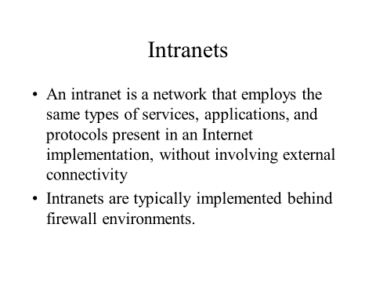
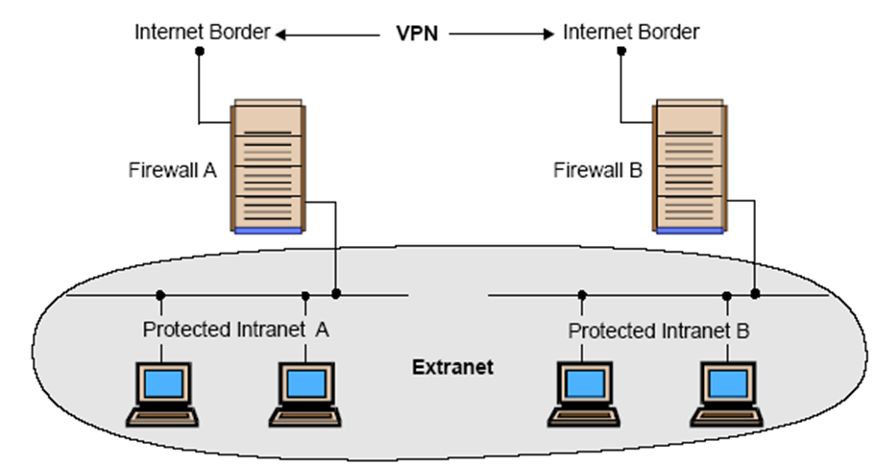
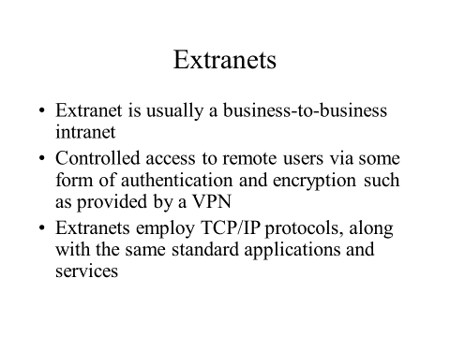

Slide 10
FIREWALL DESIGN PRINCIPLES
1. Developing Security Policy: Security policy is a very essential part of firewall design. Security policy is designed according to the requirement of the company or client to know which kind of traffic is allowed to pass. Without a proper security policy, it is impossible to restrict or allow a specific user or worker in a company network or anywhere else. A properly developed security policy also knows what to do in case of a security breach.
2. Simple Solution Design: If the design of the solution is complex. then it will be difficult to implement it. If the solution is easy. then it will be easier to implement it. A simple design is easier to maintain. we can make upgrades in the simple design according to the new possible threats leaving it with an efficient but more simple structure. The problem that comes with complex designs is a configuration error that opens a path for external attacks.
3. Choosing the Right Device: Every network security device has its purpose and its way of implementation. if we use the wrong device for the wrong problem, the network becomes vulnerable. if the outdated device is used for a designing firewall, it exposes the network to risk and is almost useless. Firstly the designing part must be done then the product requirements must be found out, if the product is already available then it is tried to fit in a design that makes security weak.

Slide 11
FIREWALL DESIGN PRINCIPLES
4. Layered Defense: A network defense must be multiple layered in the modern world because if the security is broken, the network will be exposed to external attacks. Multilayer security design can be set to deal with different levels of threat. It gives an edge to the security design and finally neutralizes the attack over the system.
5. Consider Internal Threats : While giving a lot of attention to safeguarding the network or device from external attacks. The security becomes weak in case of internal attacks and most of the attacks are done internally as it is easy to access and designed weakly. Different levels can be set in network security while designing internal security. Filtering can be added to keep track of the traffic moving from lower-level security to higher level.

Slide 12
CHARACTERISTICS OF FIREWALL
Physical Barrier: A firewall does not allow any external traffic to enter a system or a network without its allowance. A firewall creates a choke point for all the external data trying to enter into the system or network and hence can easily block the access if needed.
Multi-Purpose: A firewall has many functions other than security purposes. It configures domain names and Internet Protocol (IP) addresses. It also acts as a network address translator. It can act as a meter for internet usage.
Flexible Security Policies: Different local systems or networks need different security policies. A firewall can be modified according to the requirement of the user by changing its security policies.
Security Platform: It provides a platform from which any alert to the issue related to security or fixing issues can be accessed. All the queries related to security can be kept under check from one place in a system or network.
Access Handler: Determines which traffic needs to flow first according to priority or can change for a particular network or system. specific action requests may be initiated and allowed to flow through the firewall.

Slide 13
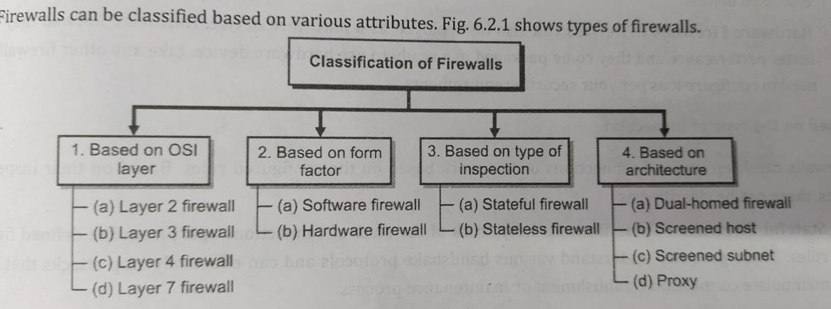

Slide 14
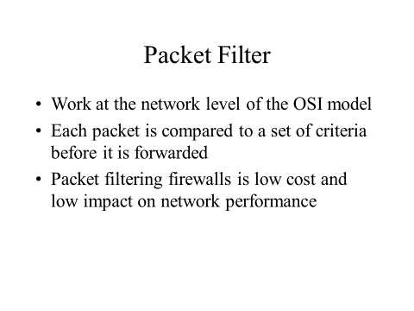
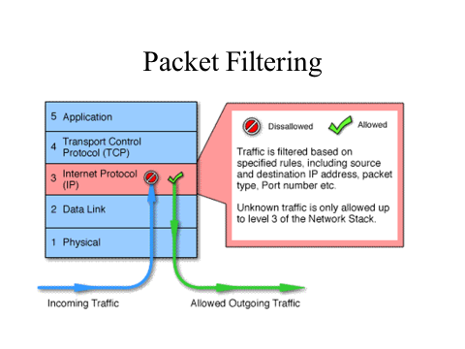

Slide 15
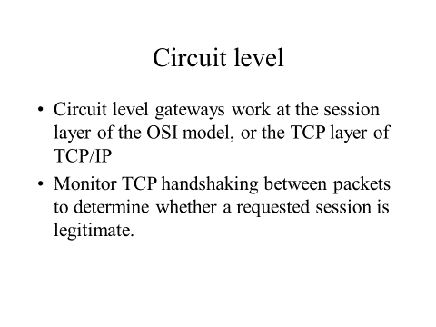
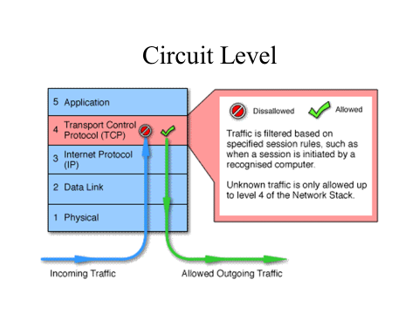

Slide 16
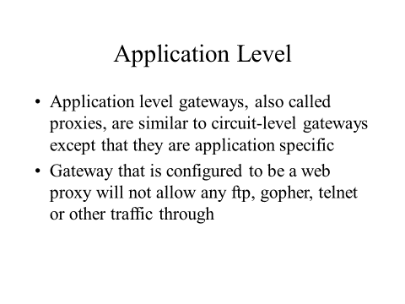
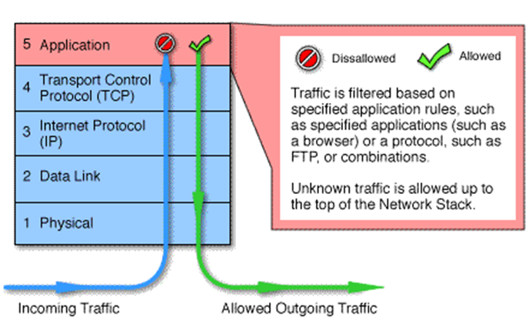

Slide 17
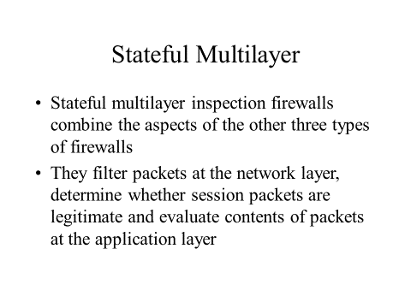
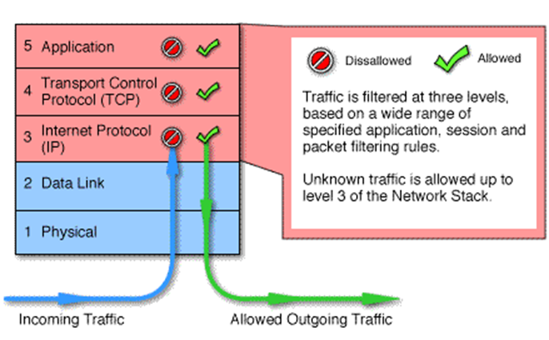

Slide 18
